Slide 1

Predictive Modeling of Income Levels based on Demographic and Employment Features
ARCHANA TOMAR

Slide 2
ACKNOWLDEGMENT
The opportunity of learning that I had with Learnbay was a great chance for learning and understanding the intricacies of the subject of Data Science, Data Visualization and Data Analytics. I would like to thank all my mentors at Learnbay for their excellent teaching style which helps in shaping my skills in Data Science and their encouragement.

Slide 3
CONTENT
Introduction
Methodology
Insights Drawn From EDA
Analysis of numeric columns
Bivariant Analysis
Multivariant Analysis
Result
Conclusion

Slide 4
INTRODUCTION
Aim of the project is to predict the income level of the population based on demographic and employment features. The dataset provided contains 32561 rows, and 16 different independent features. Aim to predict if a person earns more than 50k$ per year or not. Since the data predicts 2 values (>50K or <=50K), this clearly is a classification problem, and we will train the classification models to predict the desired outputs.
The analysis and predictions will help economists, researchers, policymakers, and analysts to study trends in income distribution, gauge the impact of economic policies, and identify disparities in wealth and possible future steps needs to be taken.

Slide 5
Data Dictionary
Age | The age of an employee
Work-class | Profession category
Final_census | Census(population of the country)
Education | Type of last (max) Education
Education_num | Years spend on studies
Marital Status | Person married or not
Occupation | Occupation
Relationship | Bounded by any relation or dependent
Race | which ethnicity belongs to the employee
Gender | gender of the employee

Slide 6
Capital-gain | profit earned when selling a capital asset
Capital-loss | financial loss incurred when selling a capital asset at a price lower than its original purchase price
Hours/week | How many working hours in a week
Country | Country where it belongs
Income threshold(Target Column) | two range of Income one is <=50k and >50K

Slide 7

METHODOLOGY
This Photo by Unknown author is licensed under CC BY-NC.

Slide 8

Read the data
Cleaning the data
Analysis of data using matplotlib, Seaborn
Hypothesis Testing
Data Modelling
Encoding
Scaling of data
Training, predicting and Evaluating the model
Logistic Regression
Random Forest Classifier
XGBoost
SVM
Feature Importance
Compare the models

Slide 9
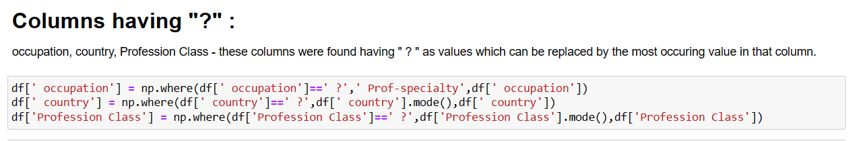

Slide 10
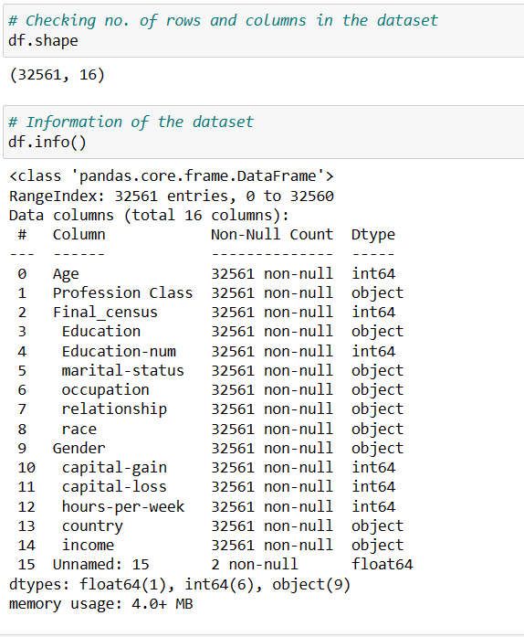

Slide 11
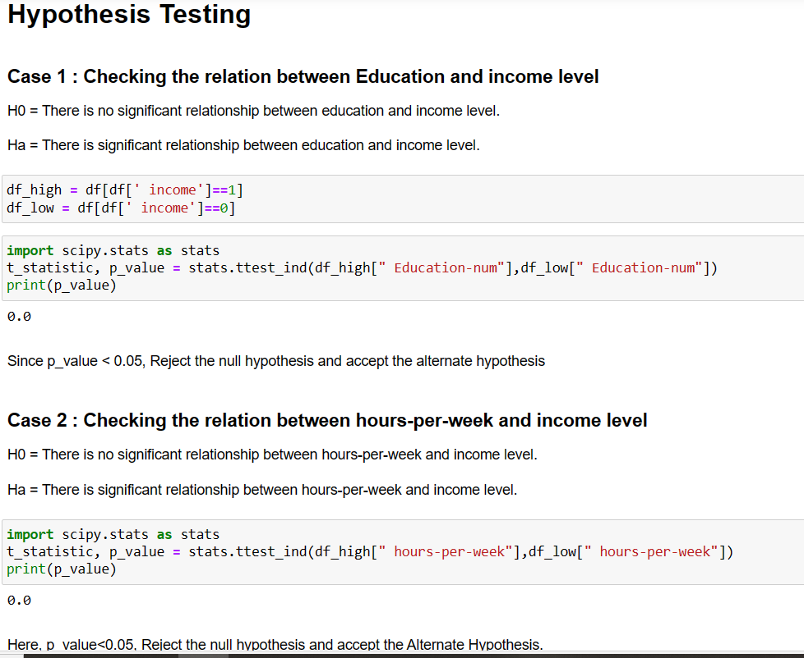
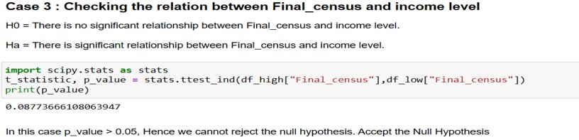

Slide 12
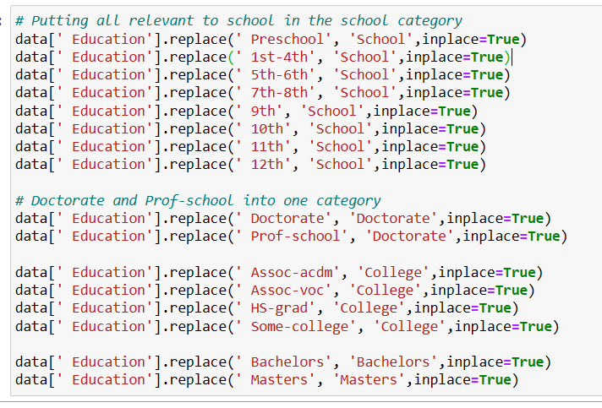

Slide 13
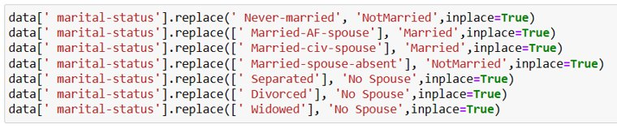
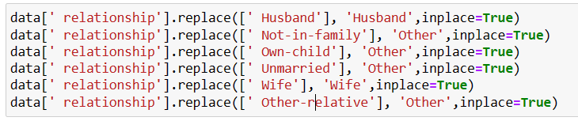


Slide 14


Slide 15
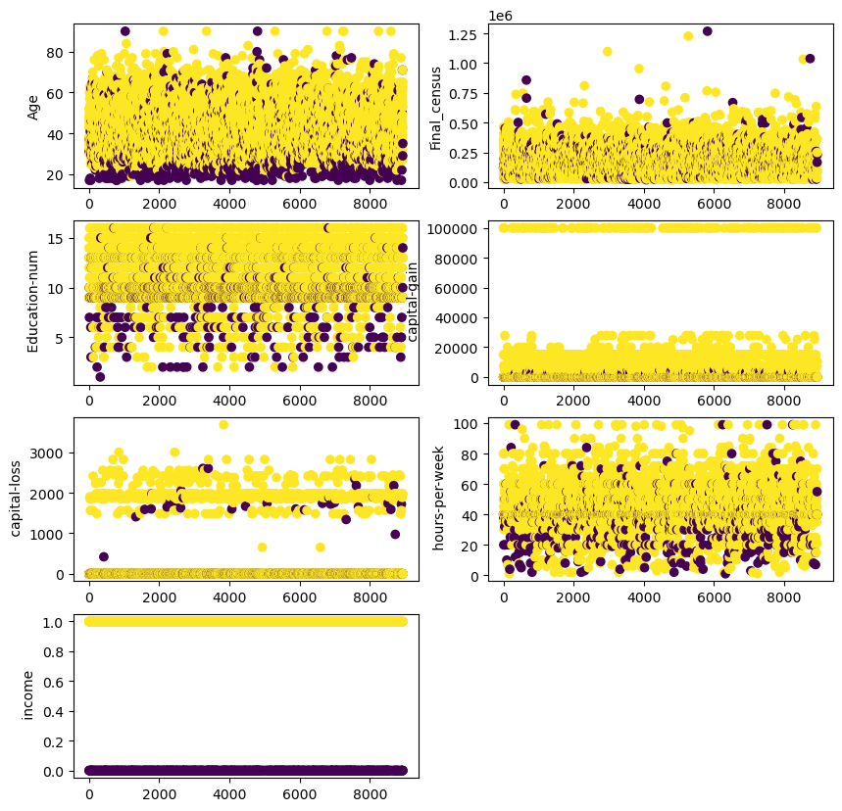
Analysis of Numeric Columns
1. Yellow Dots represent the higher income group.
2. Blue Dots represent the lower income group.
3. Age - Lower age group has high proportion of lower income group. Middle age group has both while upper age has more higher group income.
4. Final_Census which represent the population of the country shows no special relation with the income group.
5. Higher the education years more likely into the higher income group. Less education years has more lower income group.
6. Higher Capital Gain fully belongs to higher income group.
7. Capital Loss is faced by both the income groups.
8. Hours_per_week - Both the group are doing the hardwork. But more than 70 hours_per_week has more higher income group. But very less working hours also has presence of higher income group.

Slide 16

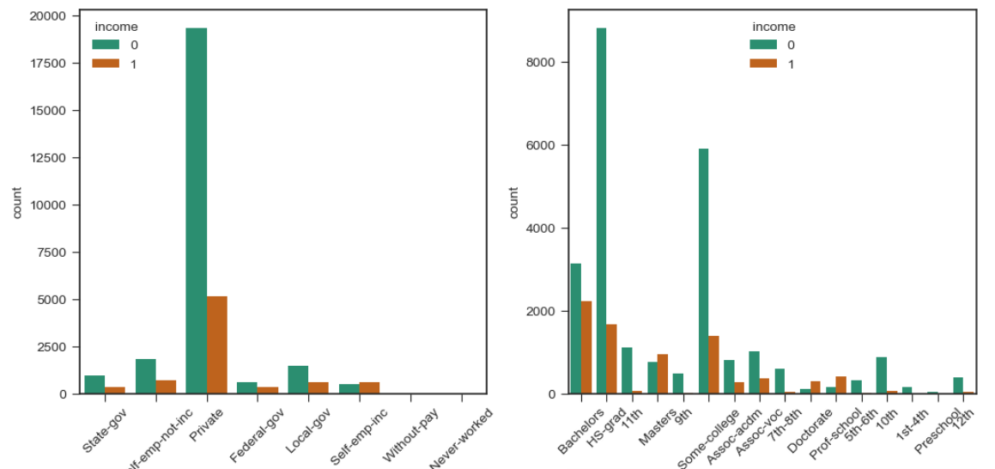
Bivariant Analysis
Ratio of people earning more than 50K is higher in case Workclass is ‘Self-emp-inc’.
People with education level as ‘Masters/Doctorate/Prof-school’ have higher ratios of >50K earning, than <=50K. Bachelors degree also has a good ratio of <=50K : >50K.

Slide 17
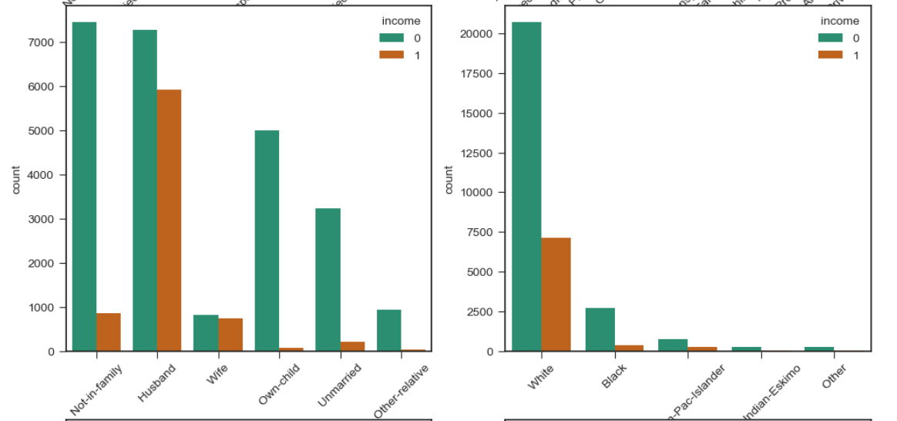
If the relationship in family is either ‘Husband/Wife’, the chances of earning more than 50K is high. People of White race have better income reasons can be historical race discrimination.

Slide 18
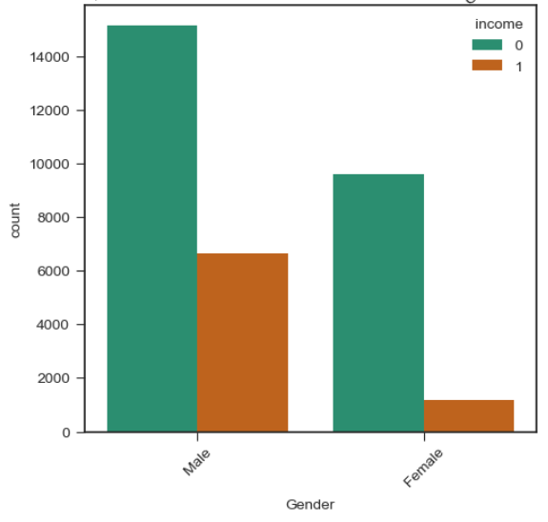
Income Distribution prefer males.

Slide 19
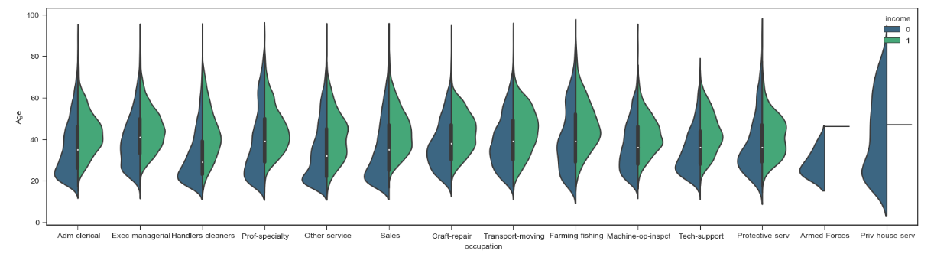
Occupation vs. Income Level with Age
More senior workers have higher salaries. Armed-forces and Priv-house-service don't have a high job salaries.
Interestingly, private house service has the widest range of age variation, however, the payment is no higher than 50K

Slide 20
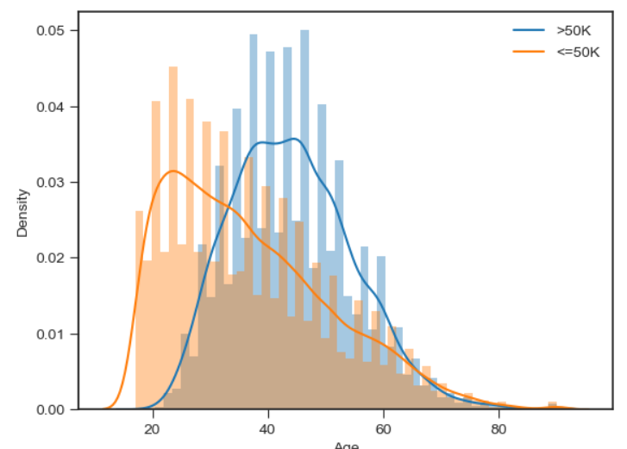
Distribution of Age and Income Level

Slide 21
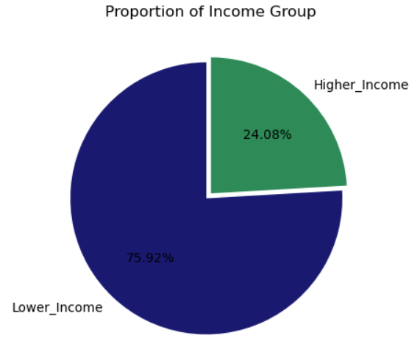
Visualizing the Target variable

Slide 22

RESULT

Slide 23
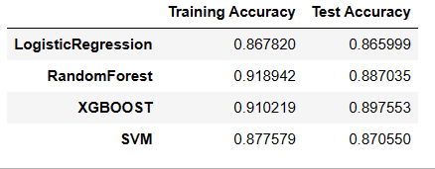
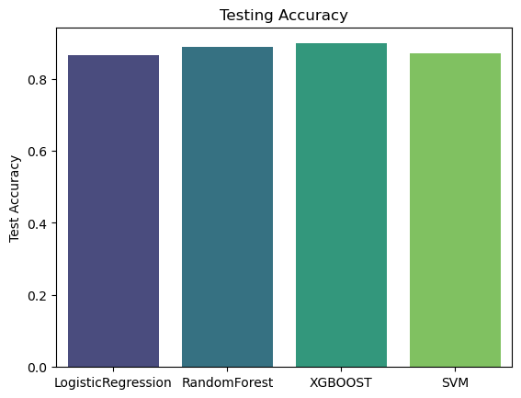
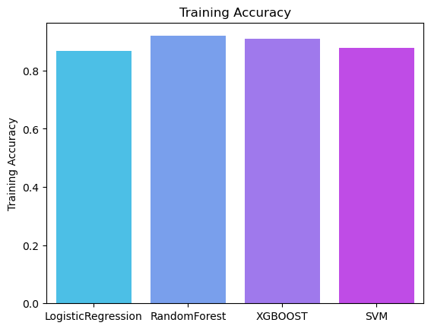

Slide 24
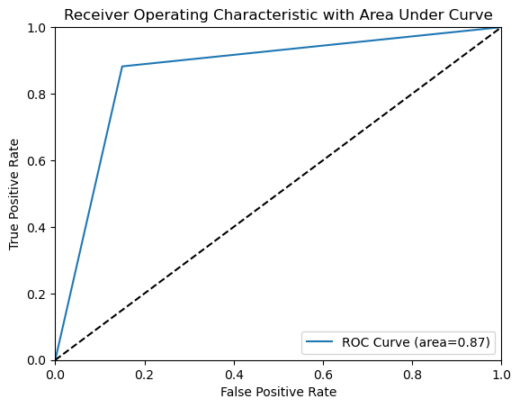
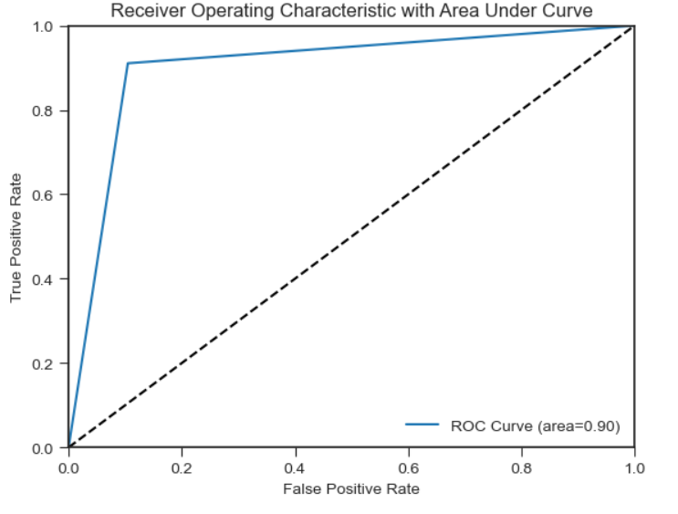
Logistic Regression
XGBoost

Slide 25

CONCLUSION
XGBoost model is giving the better testing accuracy i.e. 90%
Age, hours_per_week, gender, race, occupation, education has vital role to play in determining the income level of a person.
This project can be used to analyze and make plans to elevate the income level of a person. Investing in education, changing the profession, incentives to female, more gender-equality policies can be a better start.
Analysis can be used to distribute the funding by the government into different sectors that favour increase in income level of particular group.

Slide 26


